Slide 1


Network Integration of Multi-omic Analyses for Malignant Peripheral Nerve Sheath Tumor
Team NullFunction, 2019 NF hackathon

Slide 2
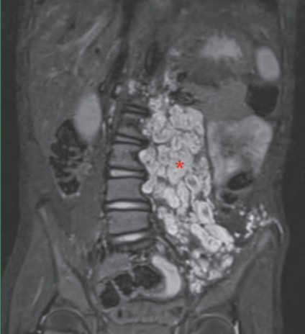
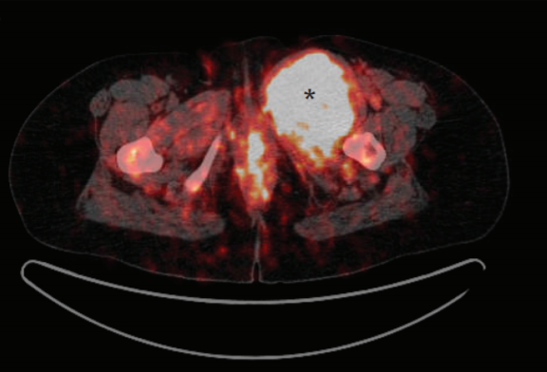
Objective
Aim1: Identify the genomic differences between Malignant Peripheral Nerve Sheath Tumor (MPNST) and Plexiform NF
Aim2: Identify potential biomarkers or drug targets based on the genomic differences
PN
MPNST
Ultimate Goals: advance diagnosis and prognostication and therapeutic targeting

Slide 3
Presentation Outline
1. Transcriptomics
Differential gene expression in MPNST vs. controls
2. Genomics
Burden of rare single nucleotide variations in MPNST vs. controls
3. Drug-Gene response
Genes targeted by drugs with various effectiveness in suppressing MPNST cell lines
4. Integration with functional protein-protein interaction
What are the hub genes?
5. Potential new drugs targeting the hub genes

Slide 4
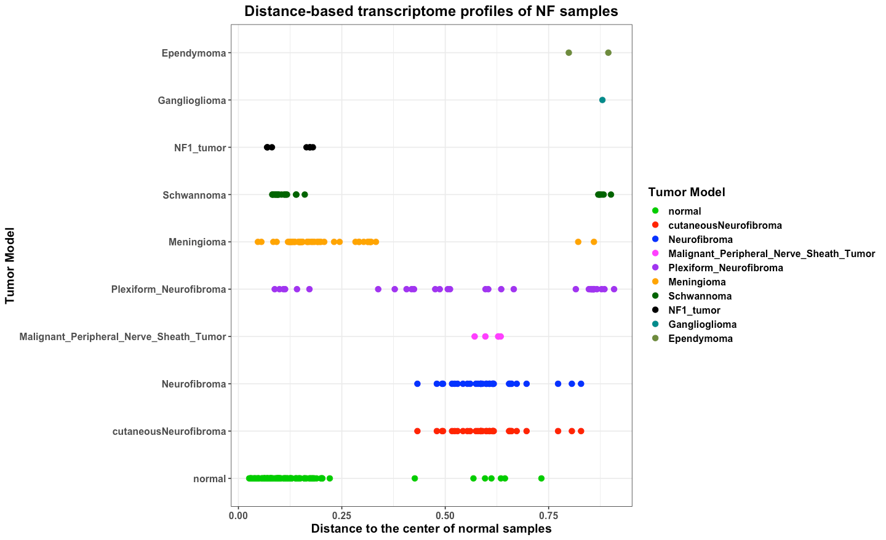
Transcriptomics – Batch Effects
Schwannoma, Meningioma,
and Normal
samples are
clearly shown two batches within each group.
Alex Tiange Cui
Cofactor Genomics
Notes:
Alex: To quickly QC RNAseq samples and to see if batch effect exist, a novel distance-based classifier were used to convert gene expression profiles into Pearson distances. The geometric center of all normal samples were defined as the baseline. In theory, all normal samples with similar gene expression profiles should cluster together, and tumor samples should drift further away from the baseline. With this simple conversion, outliers can be easily visualized. As Neurofibroma, MPNST, Gangiloglioma, Ependymoma all showing larger distance to the first group of normal samples, we believe for the second group of normal samples, either batch effect causing them have larger distance than the first group of normal samples, or there are some contamination happened in these samples, causing them a mixture of normal and tumor samples. Therefore, to make our analysis more accurate, we decide to use a subset of samples to avoid such issue.

Slide 5
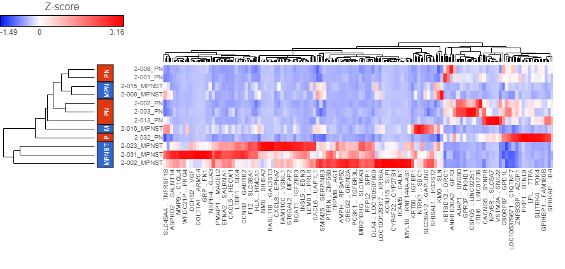
Transcriptomics – Differential Gene Expression
A Nerve Sheath Tumor Bank from Patients with NF1
6 MPNST vs 6 plexiform neurofibroma
239 differentially expressed genes ( adjusted P values < 0.05)
Chang In Moon,
Washington U. St. Louis

Slide 6
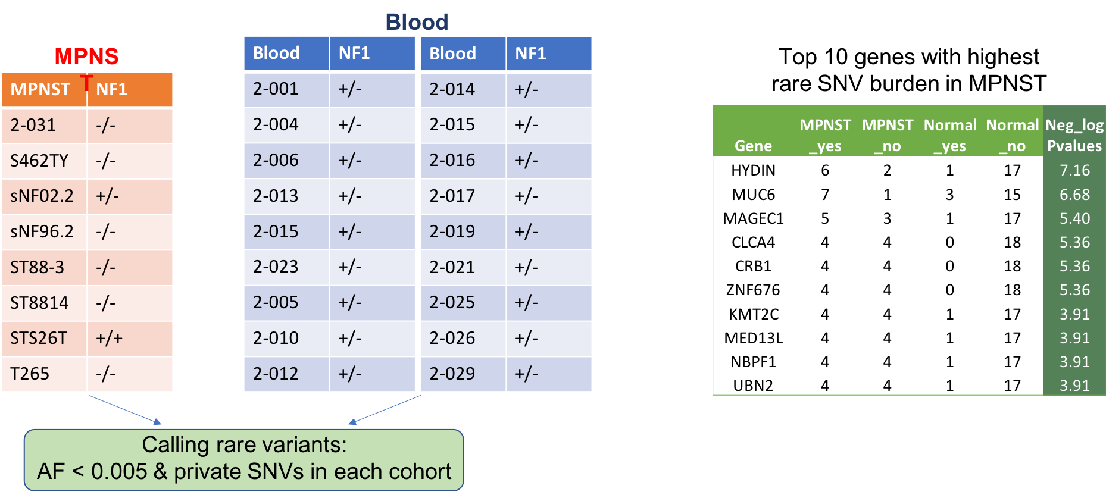
Genomics – Rare Variant Association Analysis
Higher burden:
More rare mutations in MPNST vs. controls
Xiaowei Zhu
Stanford U.
Notes:
We compared the burden of rare mutations in genes based on exome sequencing data from 8 MPNST specimens and 18 normal blood specimens. Each specimen is from a unique donor. The rare mutations are defined as the private mutations (found only once in each cohort) and with population allele frequency lower than 0.5%. We then found the corresponding genes, and used fisher’s exact test to compare the burden in the MPNST and normal samples. For instance, gene HYDIN is mutated in 6/8 MPNST samples, and in only 1/18 normal samples.

Slide 7
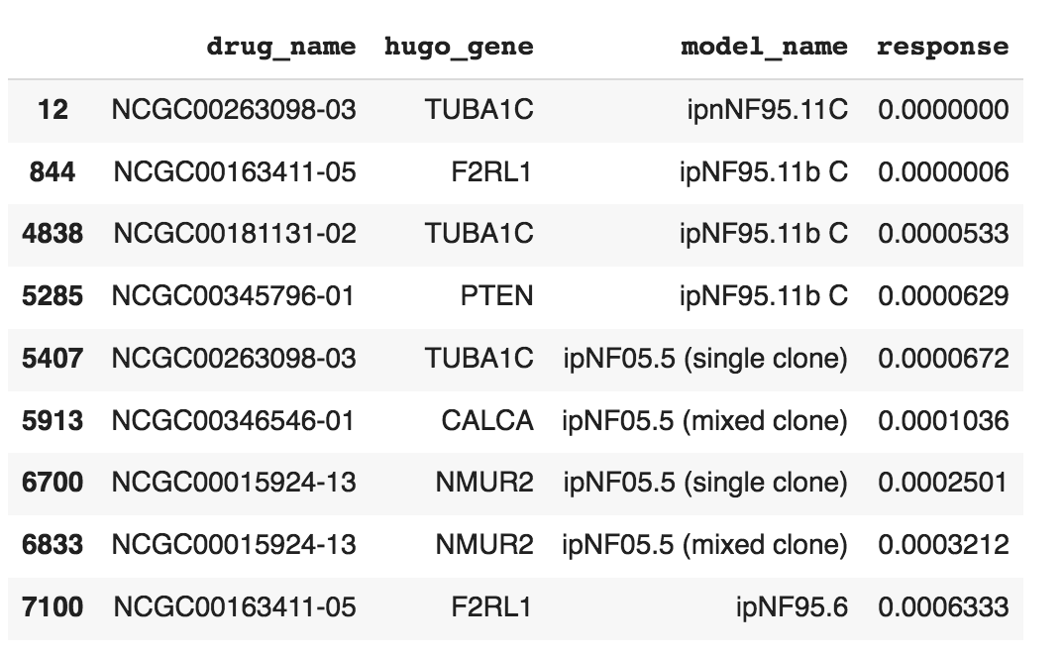
Drug-Gene Response
Response type: IC50
Combining drug and gene tables, using the median of response values
35K rows
Lu Yang
Stanford U.
Saikrithika Gandhi

Slide 8
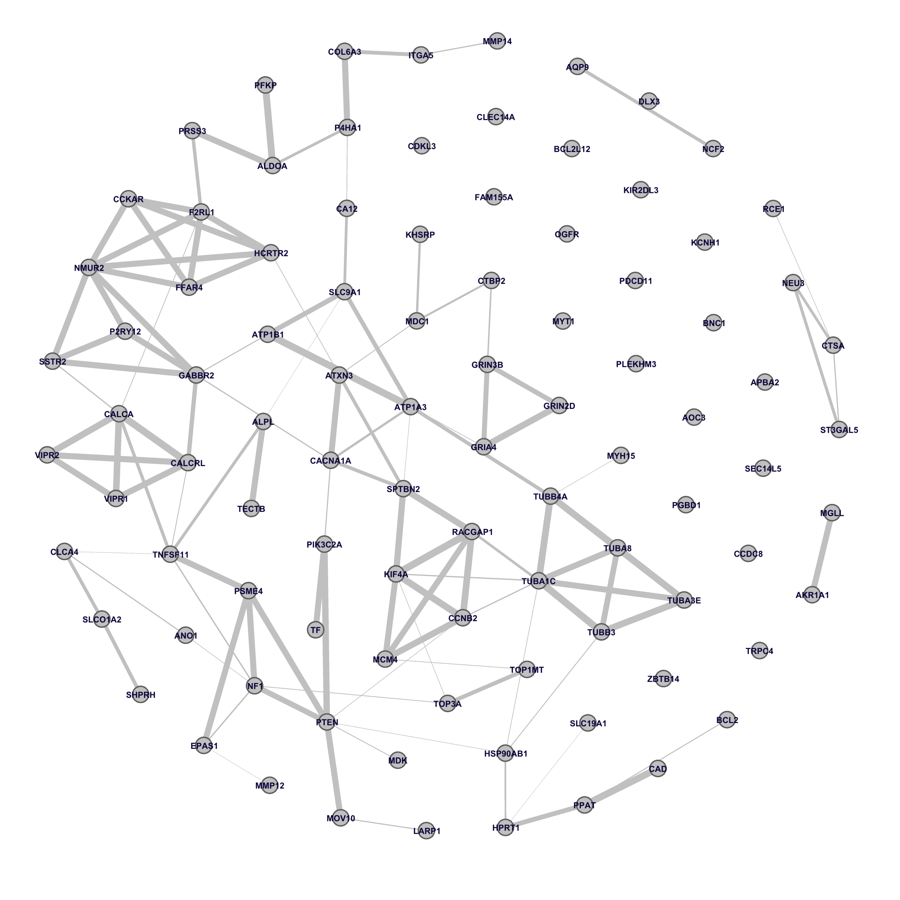
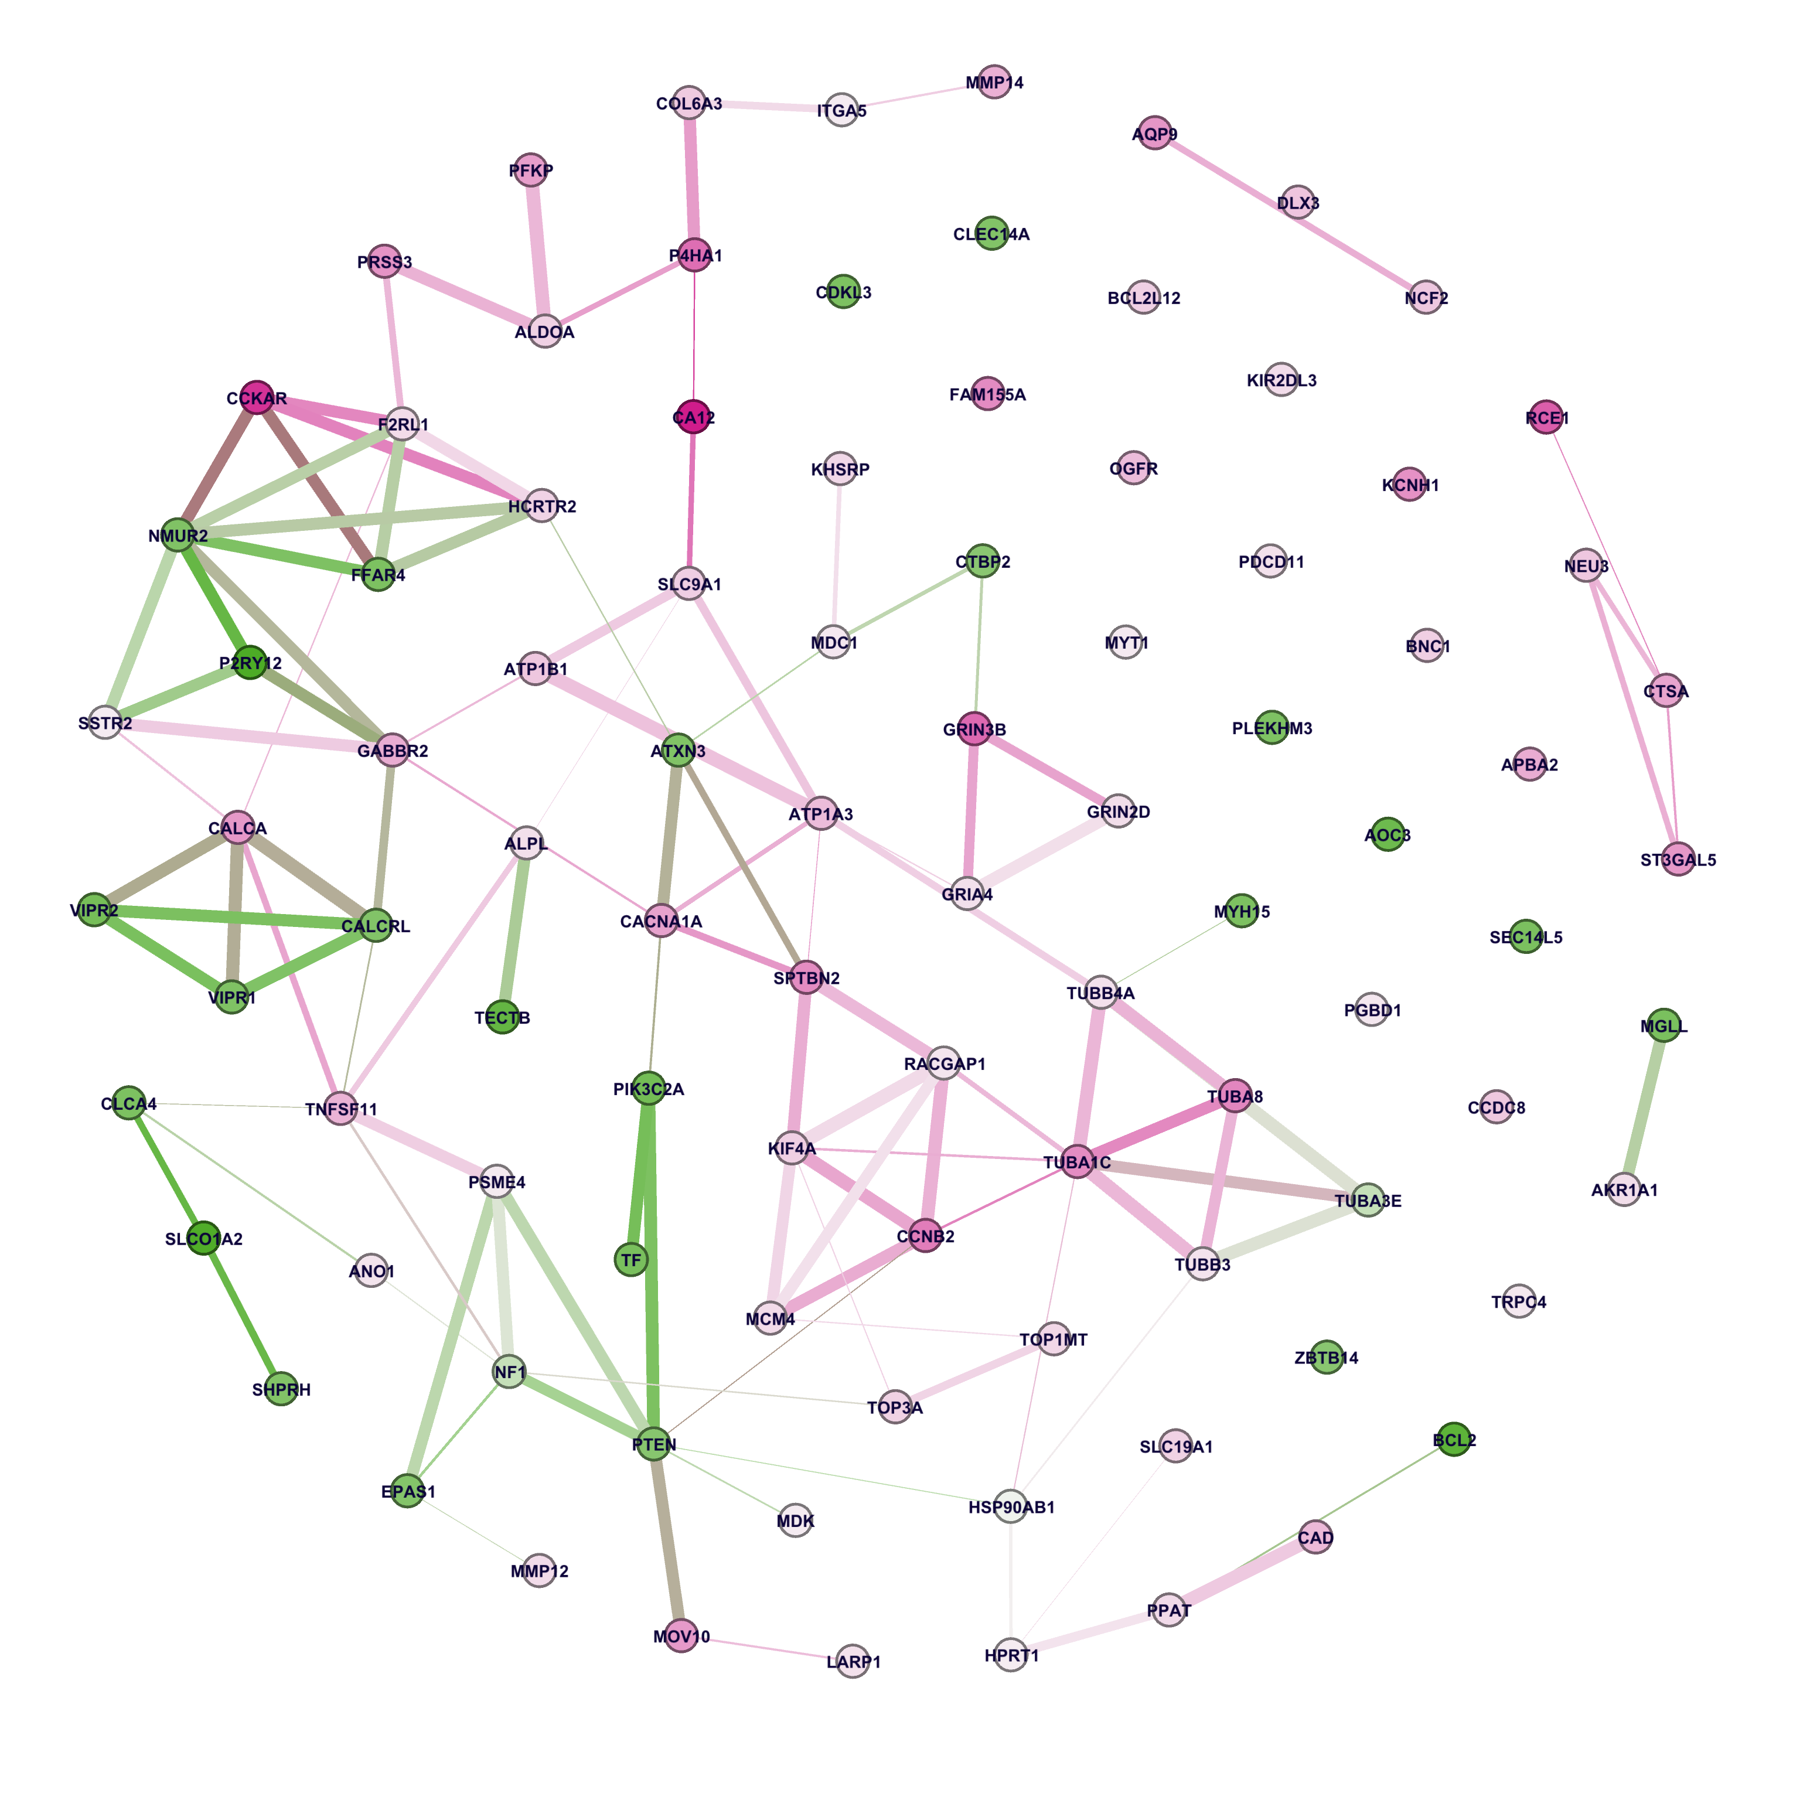
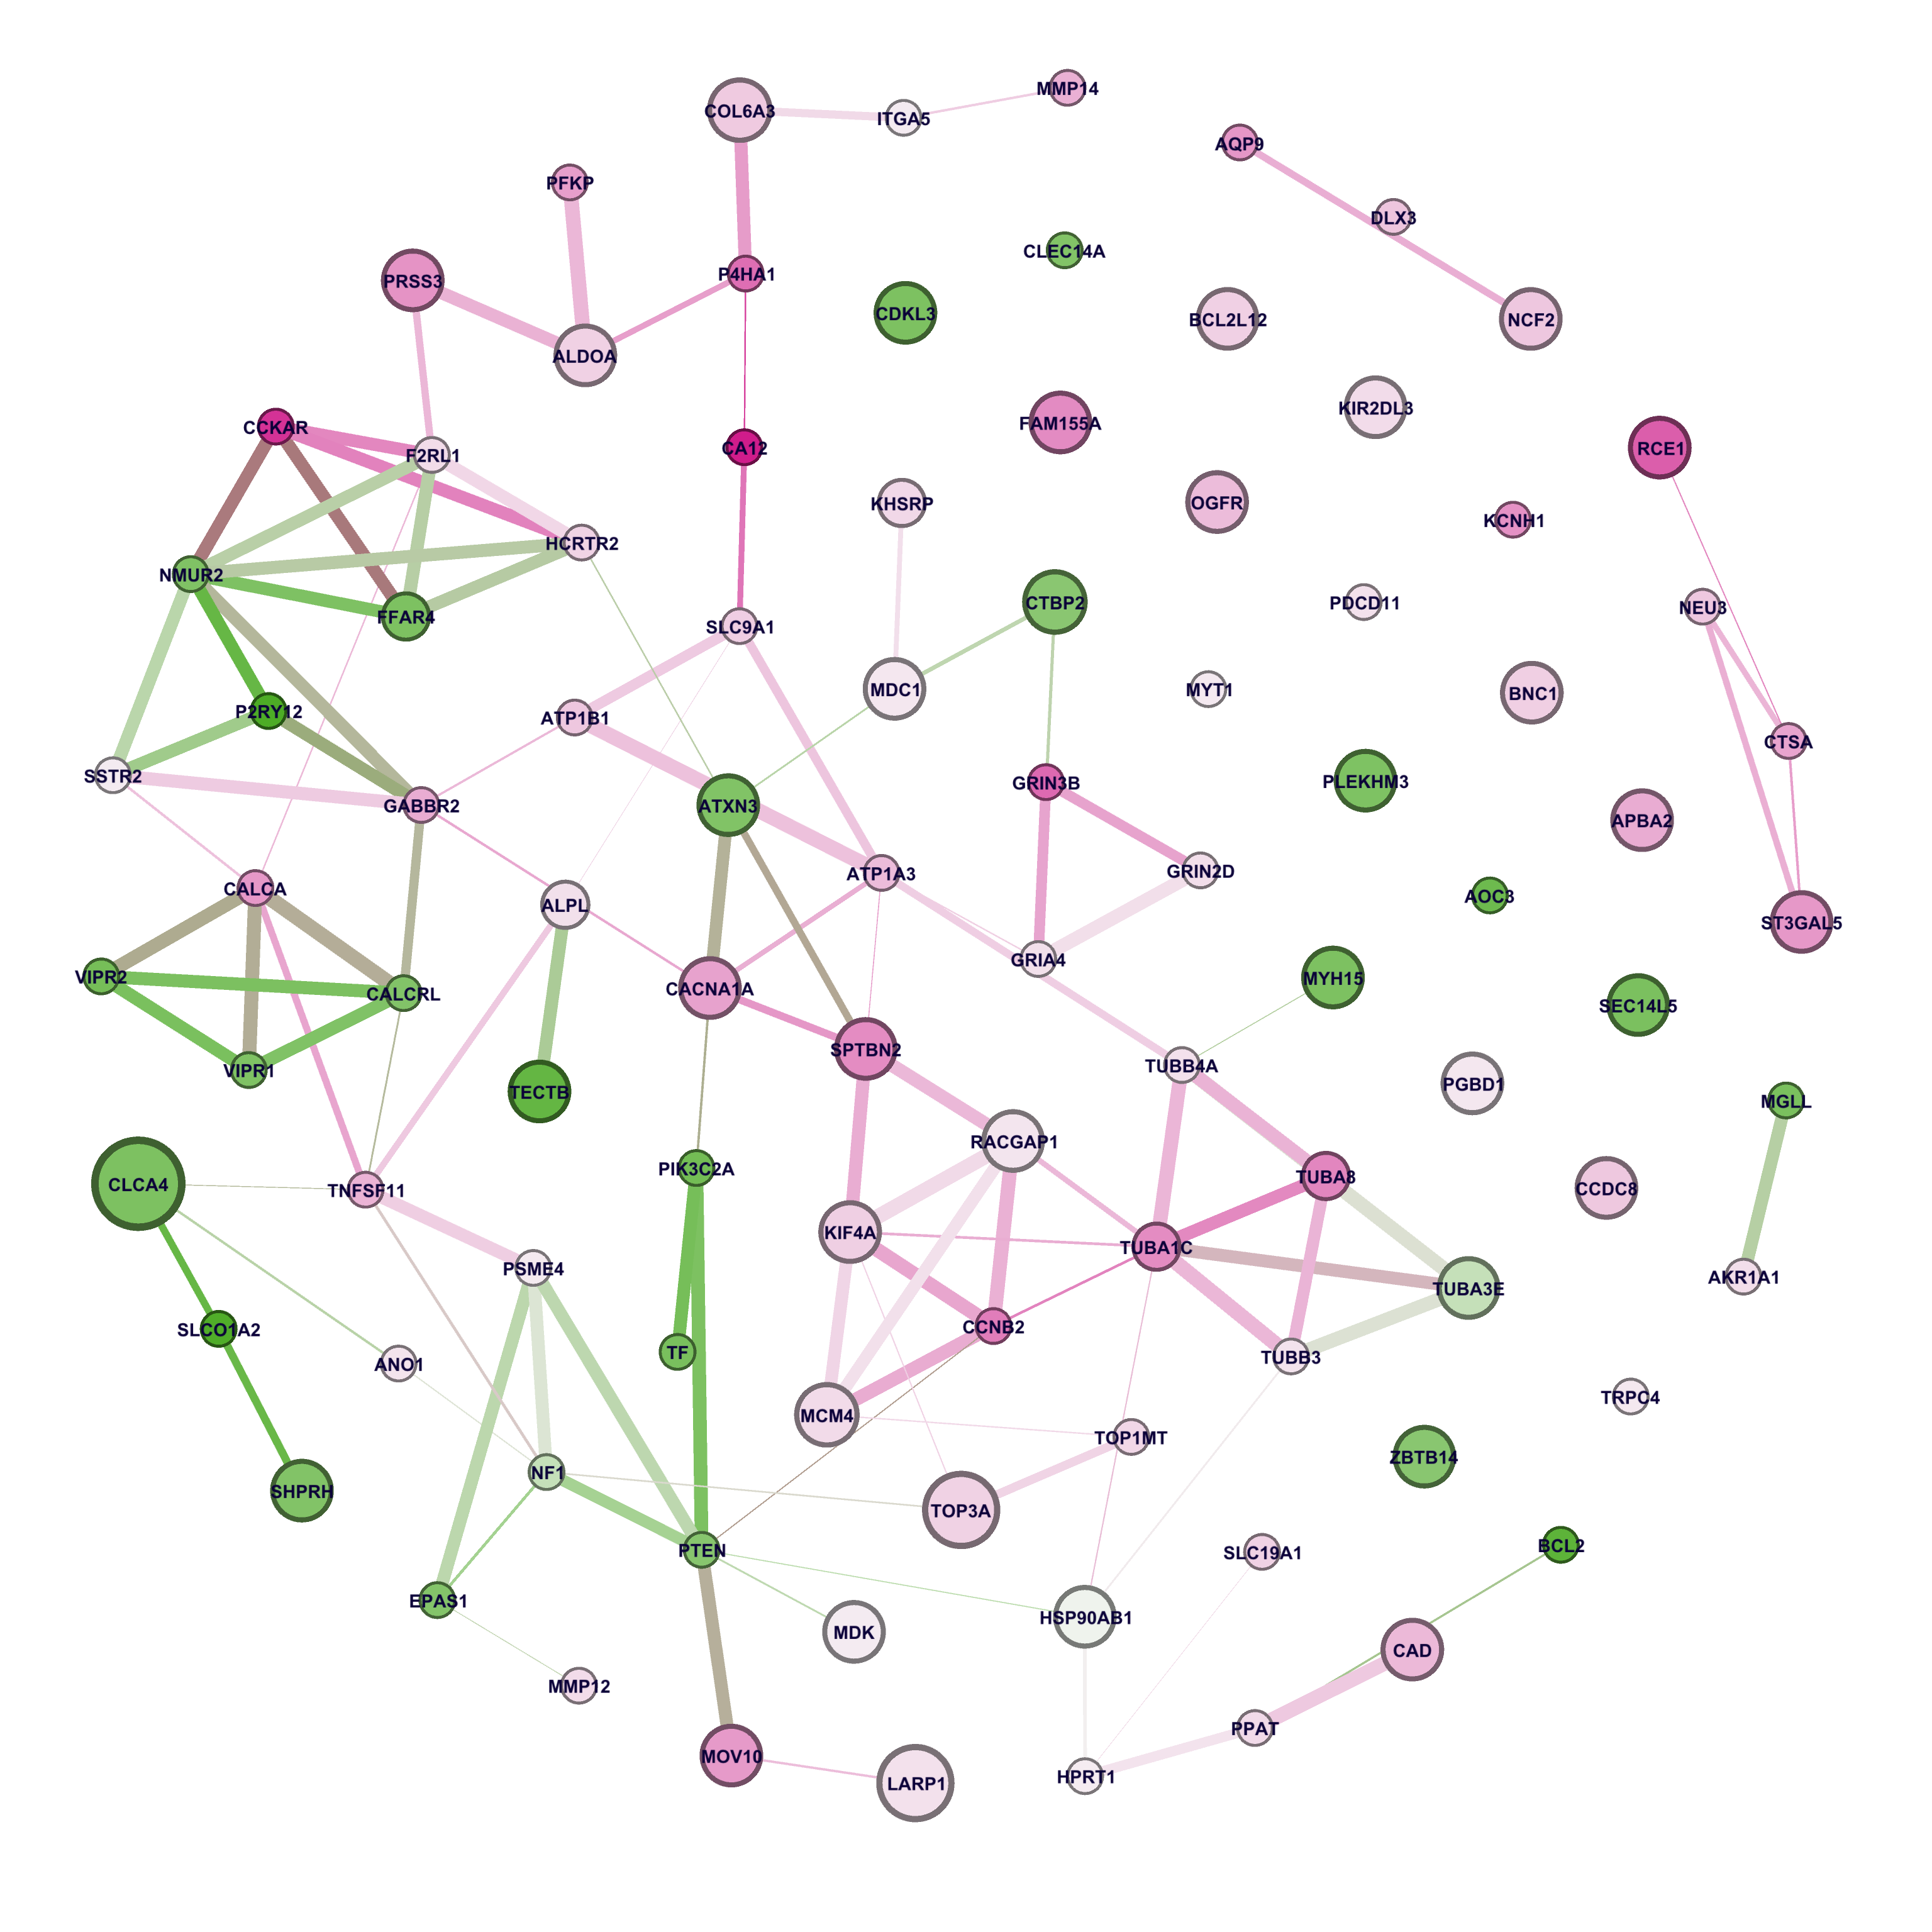
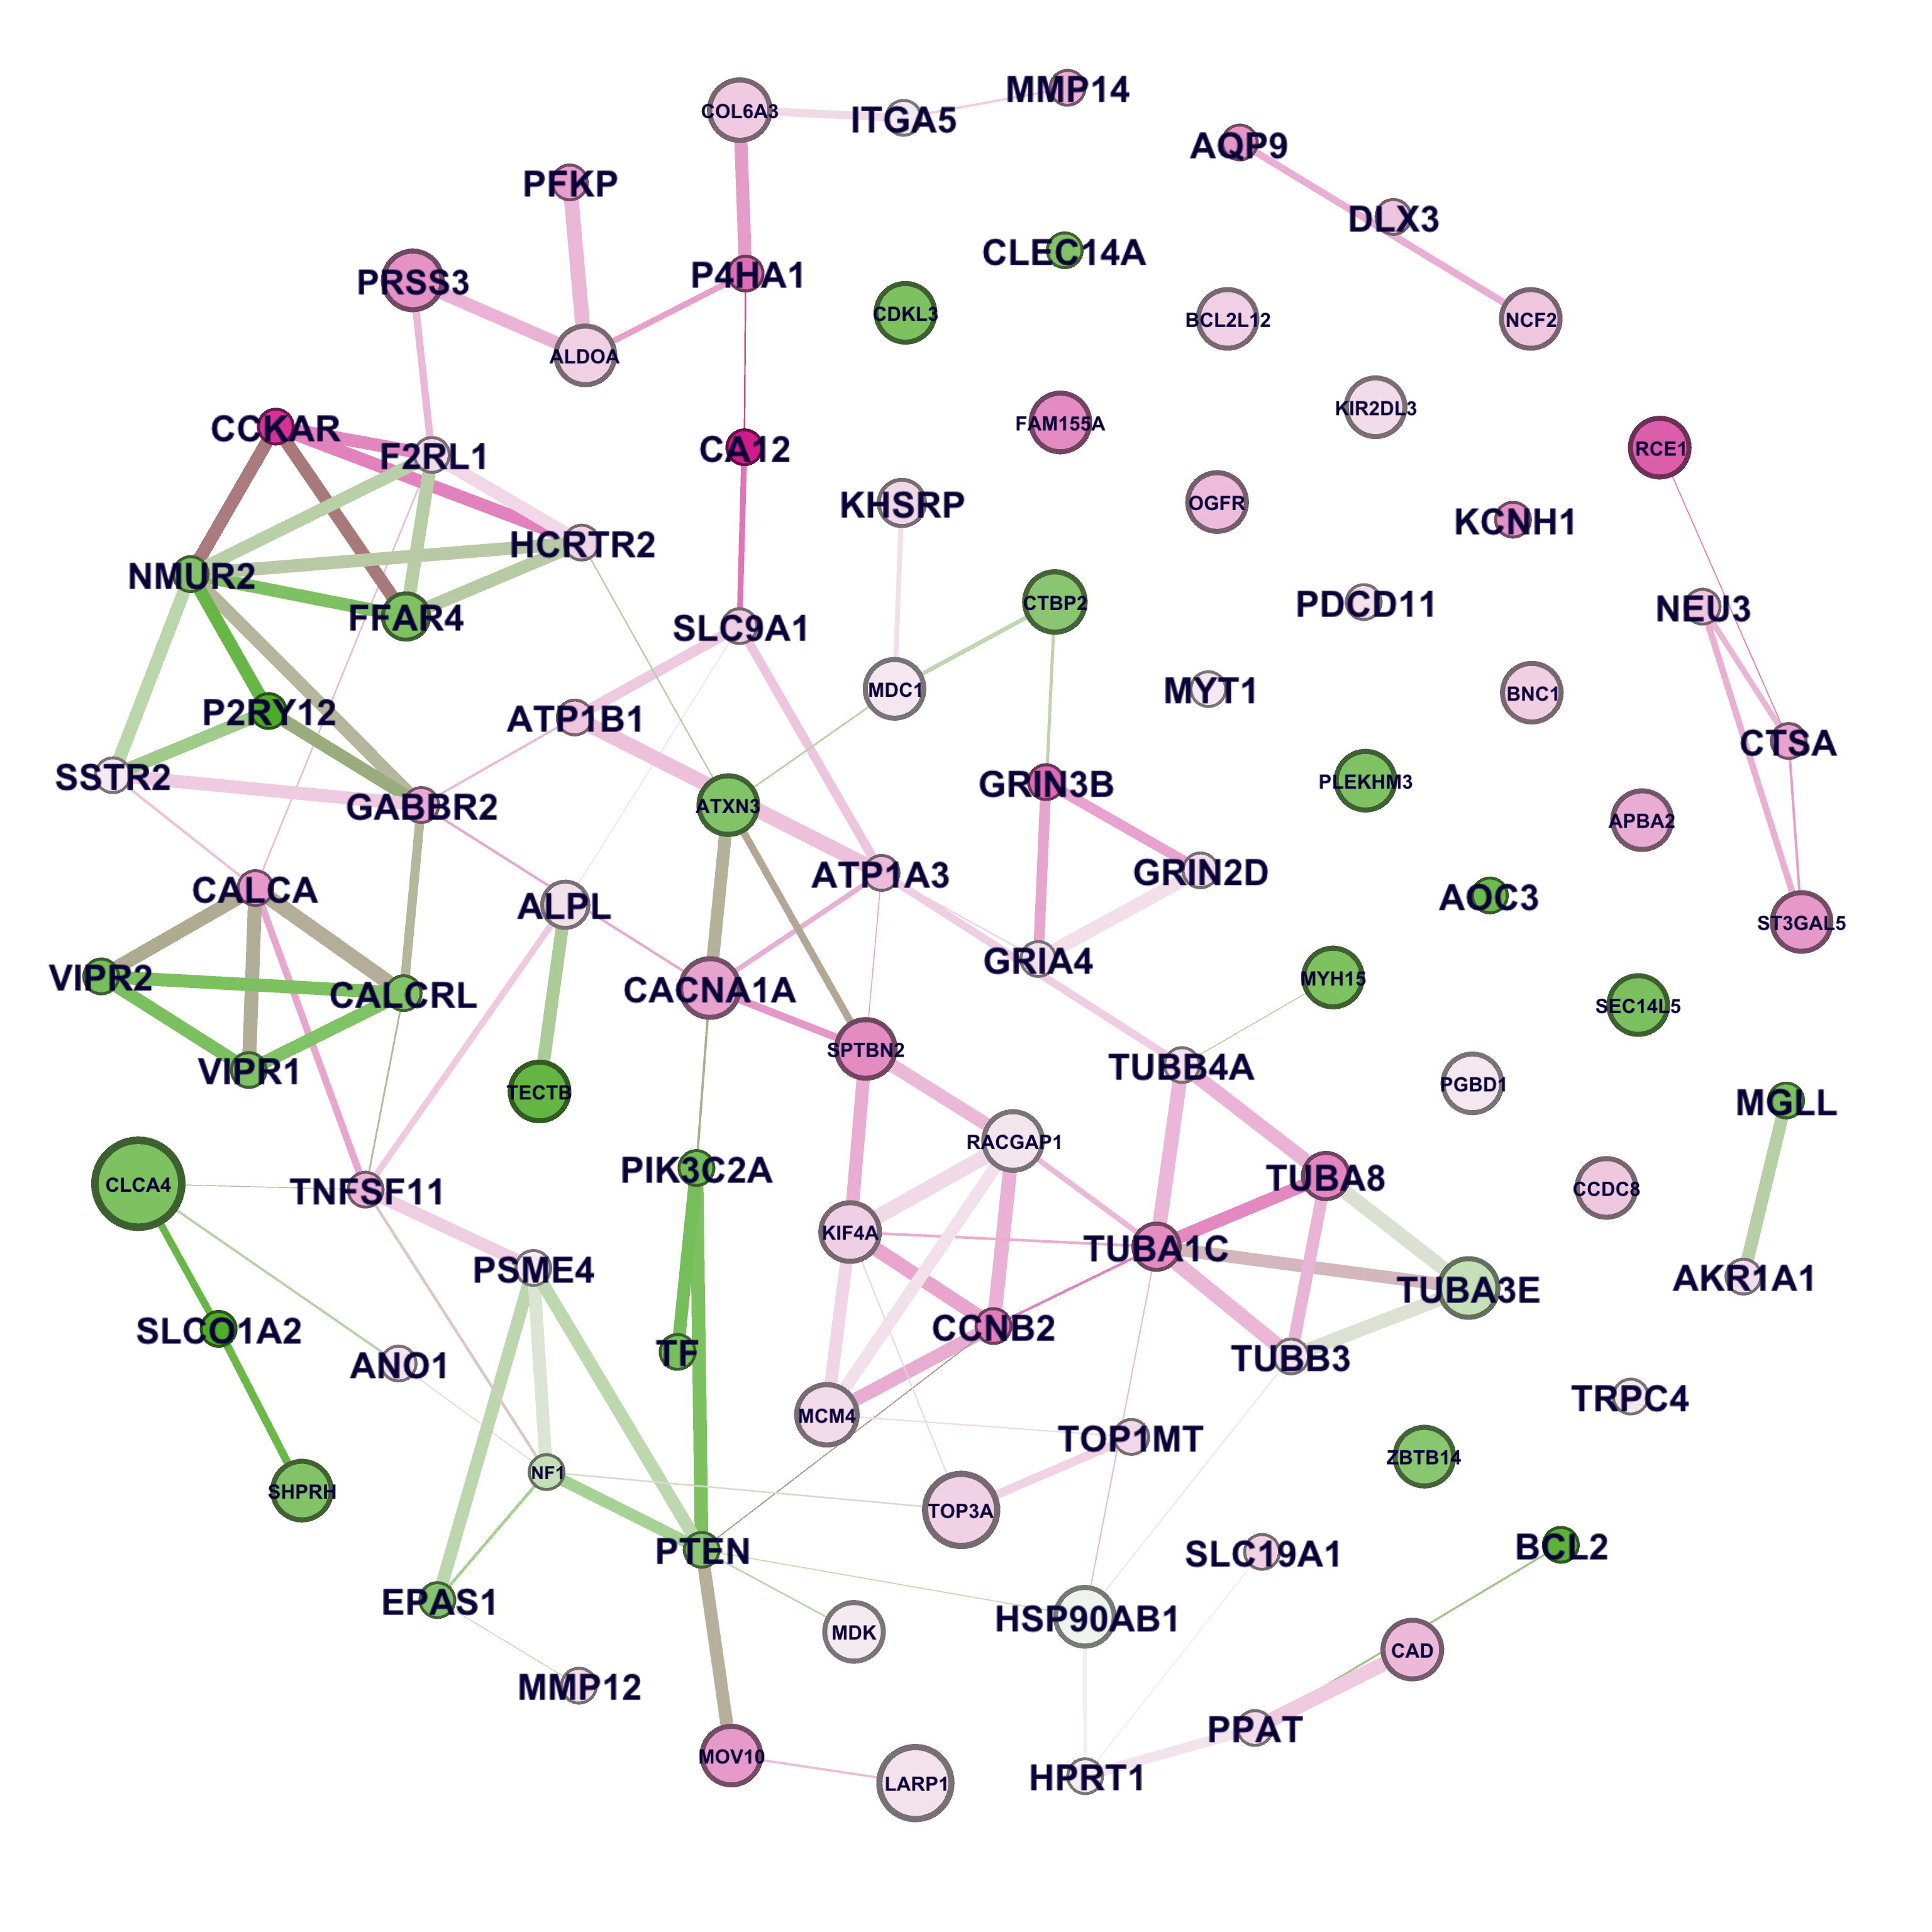
Integration with Functional Protein Protein Interactions Network
Nodes:
Genes with high burden, differential expression or potent drug response
Edges:
Protein-protein interaction (StringDB)
Color of nodes:
Gene expression in MPNST vs. Plexiform:
red, higher; green, lower
Size of nodes:
Burden of rare mutations
Size of Labels:
Drug response potency
(110-Median IC50)
Xiaowei Zhu
Stanford U.
Xiucheng Quek, DNAnexus

Slide 9
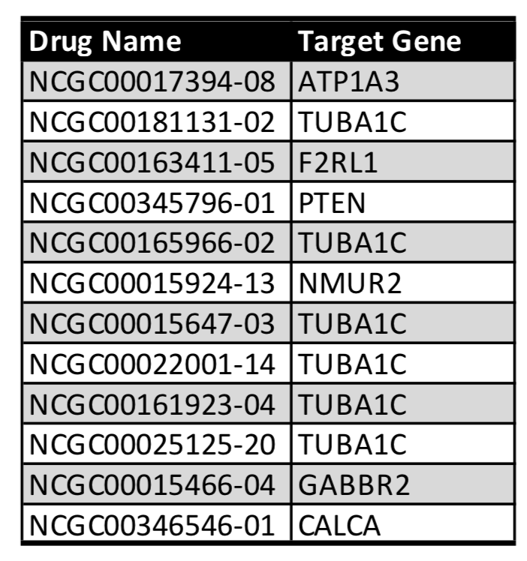
Hub Genes as the New Putative Biomarkers
Gene | Burden | RNA | Drug | Degree
TUBA1C | 1.18 | 6.84 | 0.16 | 8
NMUR2 | 0.00 | -3.54 | 0.00 | 7
PTEN | 0.00 | -3.16 | 0.31 | 7
ATP1A3 | 0.00 | 4.90 | 0.10 | 6
CALCA | 0.00 | 6.34 | 0.01 | 6
F2RL1 | 0.00 | 3.64 | 0.01 | 6
GABBR2 | 0.00 | 5.54 | 0.06 | 6
KIF4A | 2.45 | 4.16 | NA | 6
TNFSF11 | 0.00 | 5.26 | 0.03 | 6
PTEN gene:
Lower expression in MPNST (p=0.04)
Chemical targeting PTEN has good effectiveness in suppressing MPNST cell line growth (median IC50=0.31 uM)
Interacting with 7 other proteins with potential functional relevance in MPNST
A known tumor suppressor that is mutated in a large number of cancers at high frequency.
Xiaowei Zhu, Lu Yang
Stanford U.
Saikrithika Gandhi

Slide 10
Summary
We have focused on the genomic and drug-screening data in order to find MPNST-relevant genes with 1) RNA-Seq Analysis, 2) rare-mutation associations, 3) drug-gene response, and 4) functional protein-protein interaction networks
Integration of multi-omics data could potential help to enrich weak signals present in each individual analysis.
Based on these methods, PTEN loss can serve as a biomarker to predict possible response to the drug PI3K-beta inhibitor(NCGC00345796-01).
The scope of our analysis is limited by the size of cohort (6 vs. 6 in RNA-seq, and 8 vs. 18 in Exome sequencing), and thus is unlikely to fully capture the heterogeneity among MPNST. More sample size is needed.

Slide 11

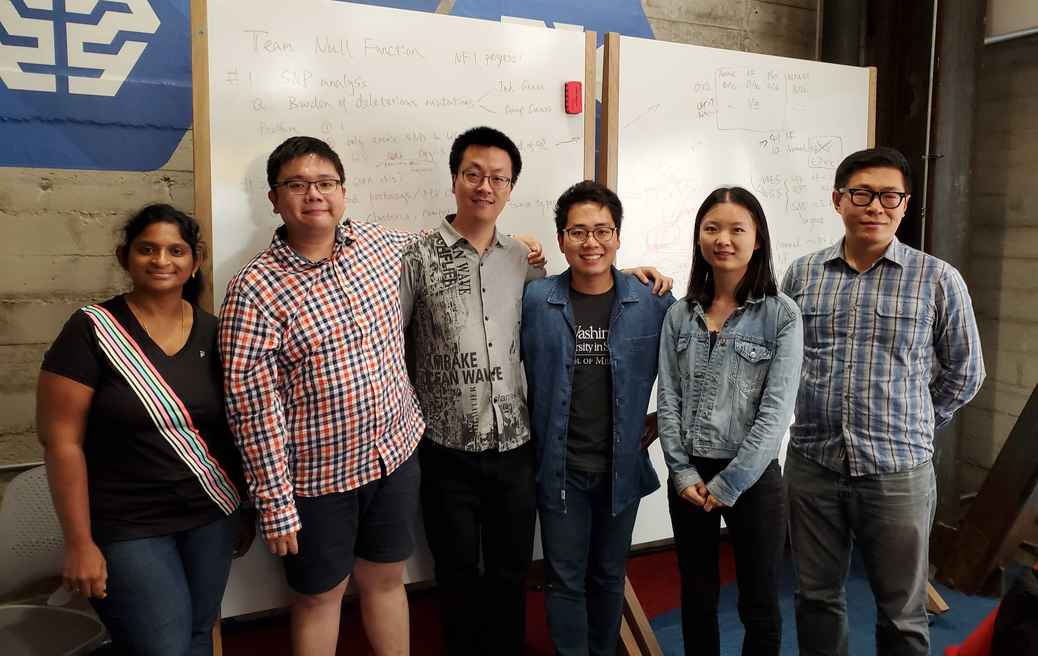

TEAM NULL FUNCTION – 2019 NF Hackathon
Saikrithika Gandhi (Drug discovery) Researcher, saikrithi@gmail.com
Xiucheng Quek (PPI network) DNAnexus, xquek@dnanexus.com
Xiaowei Zhu (Burden test, PPI network), Stanford University, xwzhu@stanford.edu
Chang In Moon (RNA analysis, presenter), Washington University in St. Louis, moonchangin@wustl.edu
Xiangying Sun (RNA analysis), Thermo Fisher
Tiange Alex Cui (RNA analysis, Team logo), Cofactor Genomics, alextreecn@gmail.com
Lu Yang (Drug discovery), Stanford University, luy@stanford.edu
GITHUB PAGE: https://github.com/SVAI/nullfuction

